Slide 1
Burn Unit
Nikita, Jacob, Jenna, and Marie

Slide 2
Patient Information
Our patient is a nineteen year old female that came into the emergency room two hours ago with burns. She claims to have been draining the water from freshly boiled noodles when the pot slipped and all of the contents spilled onto her left forearm. The skin instantly blistered and began to swell slightly. As she was unsure of what to do, she decided to immediately seek medical attention.

Slide 3
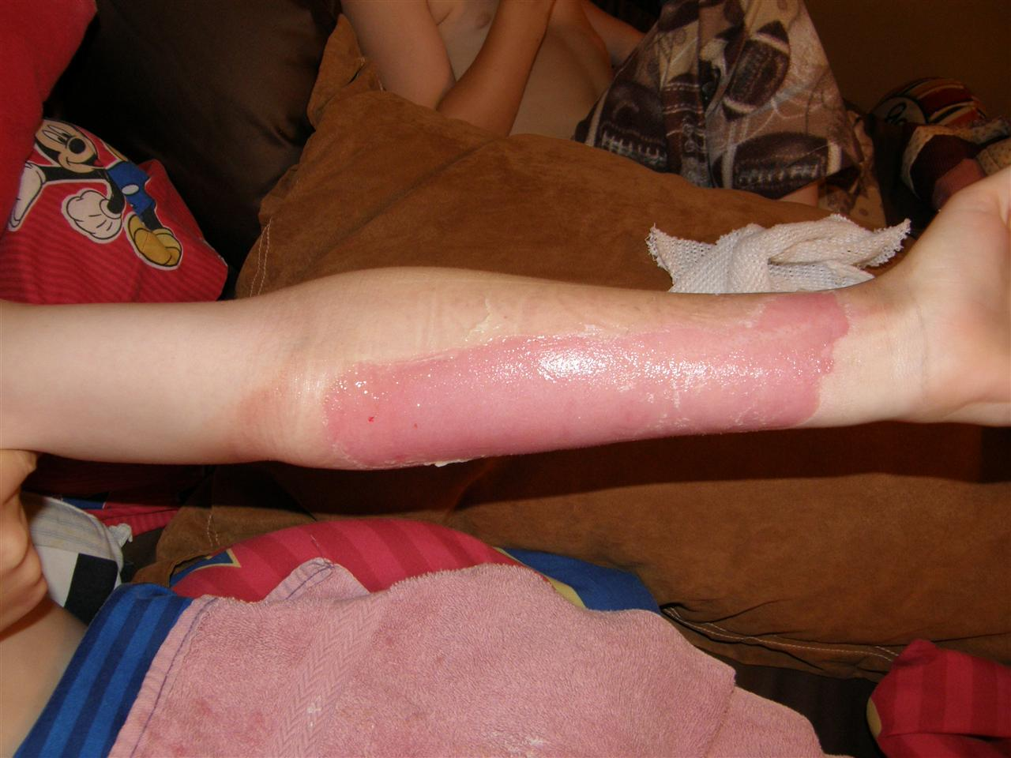
Type of Burn
Upon examining the affected skin, our patient seems to be experiencing second degree burns. She exhibited the following symptoms:
Swelling
Red, splotchy skin
Blistering
Based on these symptoms and the size of the affected area, we diagnosed her burns as second degree.

Slide 4
Layers and Accessory Structures
This second degree burn causes destruction of tissue layers deep into the skin. It effects the following layers of the skin:
Epidermal layers
Dermal layers
Based on the burn, it can be classified as superficial, where the burn only extends to the outermost part of the dermis, or deep, where the burn causes damage to deeper parts of the dermis. We classified our patient's burn as a deep burn.

Slide 5
Treatment
Rinse the affected skin with cool water until pain subsides.
Clean the burn area with mild soap and water.
Pat the area dry with a clean cloth or gauze.
Apply antibiotic ointment directly to the affected area each time the burn is cleaned.
Loosely wrap a bandage around any burned skin with unbroken blisters that could become dirty or irritated.

Slide 6
Body systems affected
Nervous – The body sends out nerve impulses to stimulate pain in the burned area of skin.
Integumentary – Burns of the second degree involve the epidermis as well as part of the dermis layer of skin.
Immune – This system is unable to protect the body efficiently as open wounds are prone to infection.

